Slide 1
Analysis on Avocado Prices
George Jiang, Benson Yu, Katie Blau

Slide 2

Explanation of Topic
Popularity of avocados in recent years
Fluctuations in price, availability, and importing concerns
Price trends
Variety of types, region, seasonality, etc.
Examples of questions:
Demand in different regions
Number sold in summer vs. winter

Slide 3
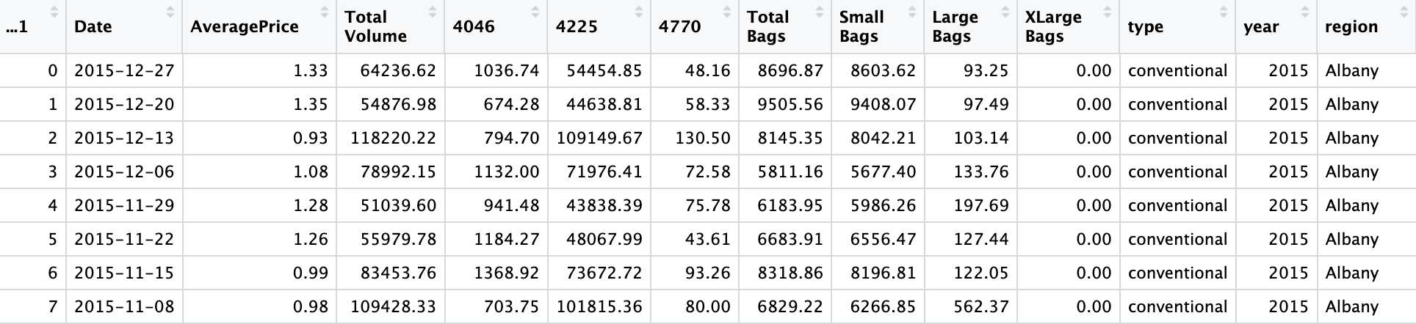
Data Set
First 8 columns of data
How the data was collected - Hass Avocado Board
Bias in the data set
Cleaning data
Adding column for day of the week to compare weekend vs weekday
Outliers
Omitting columns that were not relevant
PLU codes

Slide 4
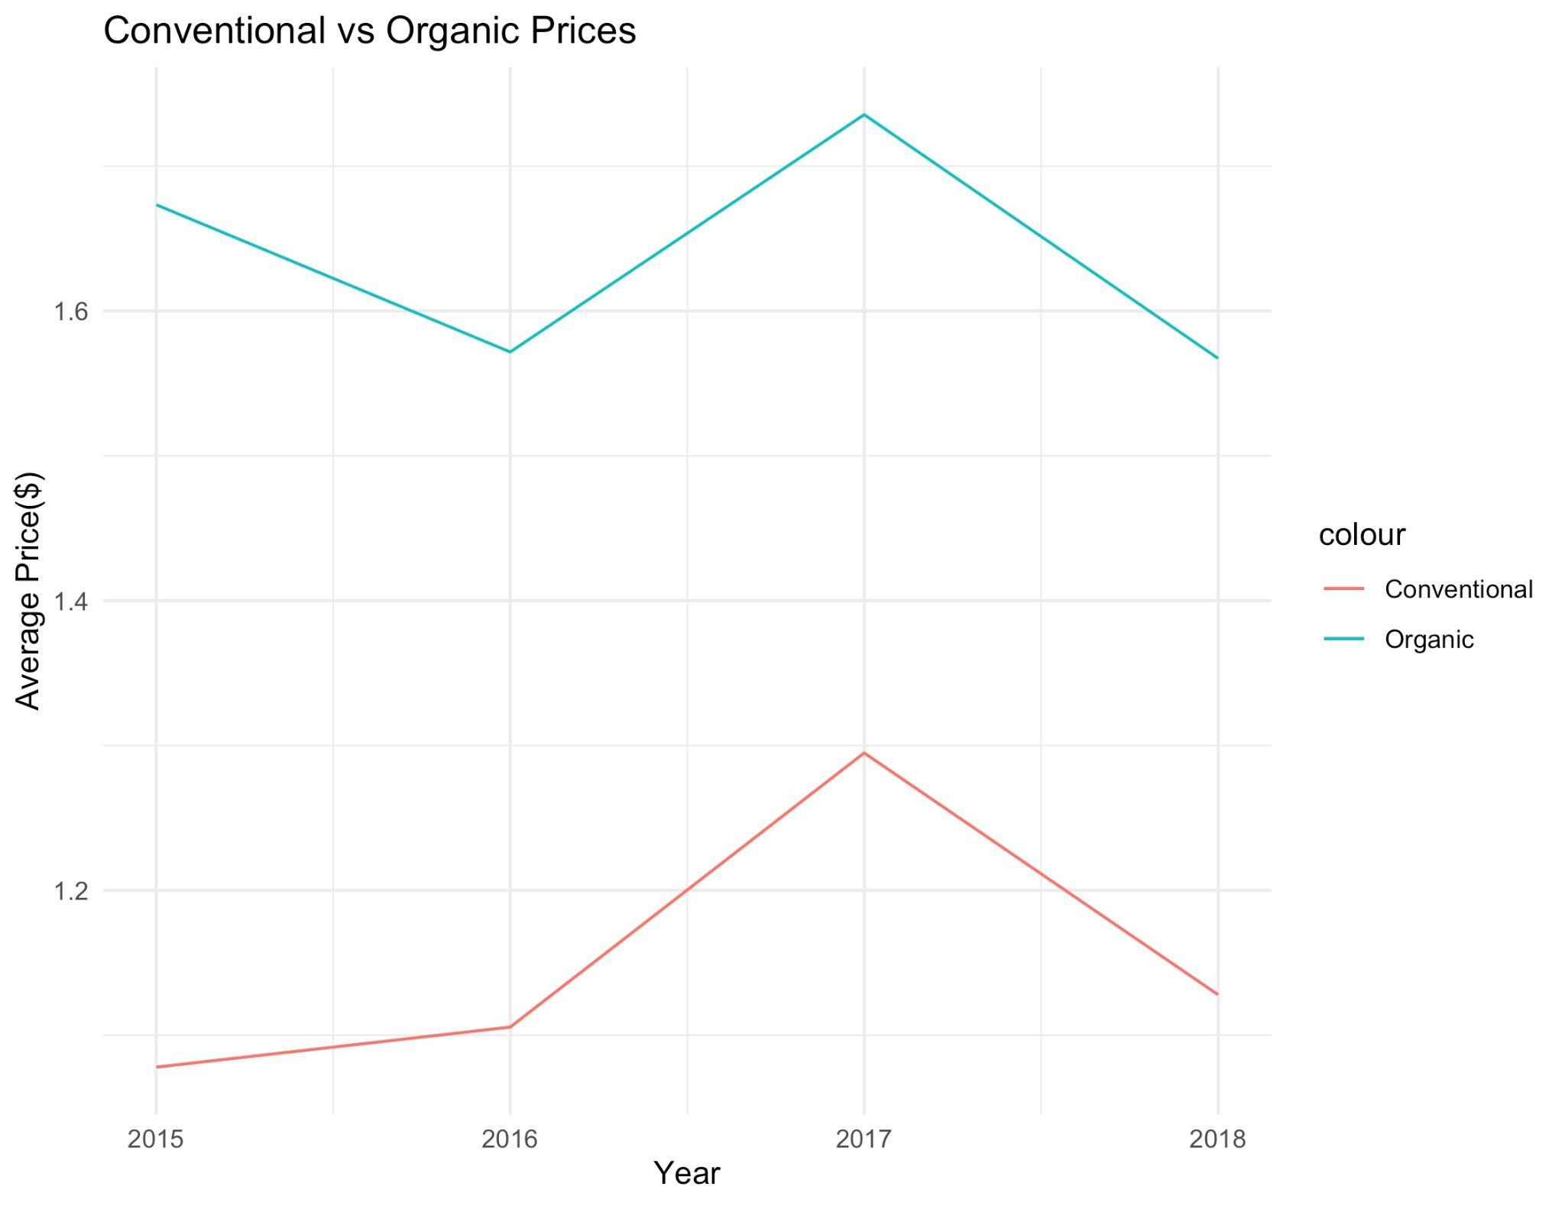
Hypothesis Question #1
Are organic avocados more or less expensive than conventional avocados?
H0 : μ_{conventional price} = μ_{organic price}
Ha : μ_{conventional price} < μ_{organic price}
Alpha = .05
Test statistic = 105.59
Used sample mean as estimate of population mean
Assumptions = sample size is large enough
P-value < 0.0001, reject null hypothesis

Slide 5
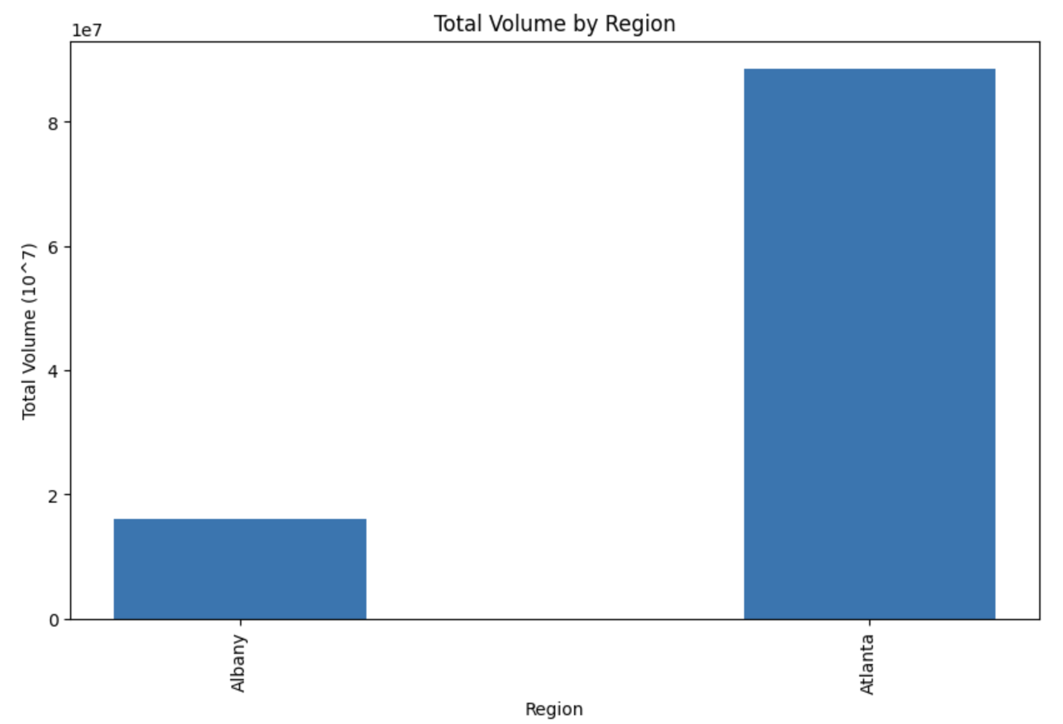
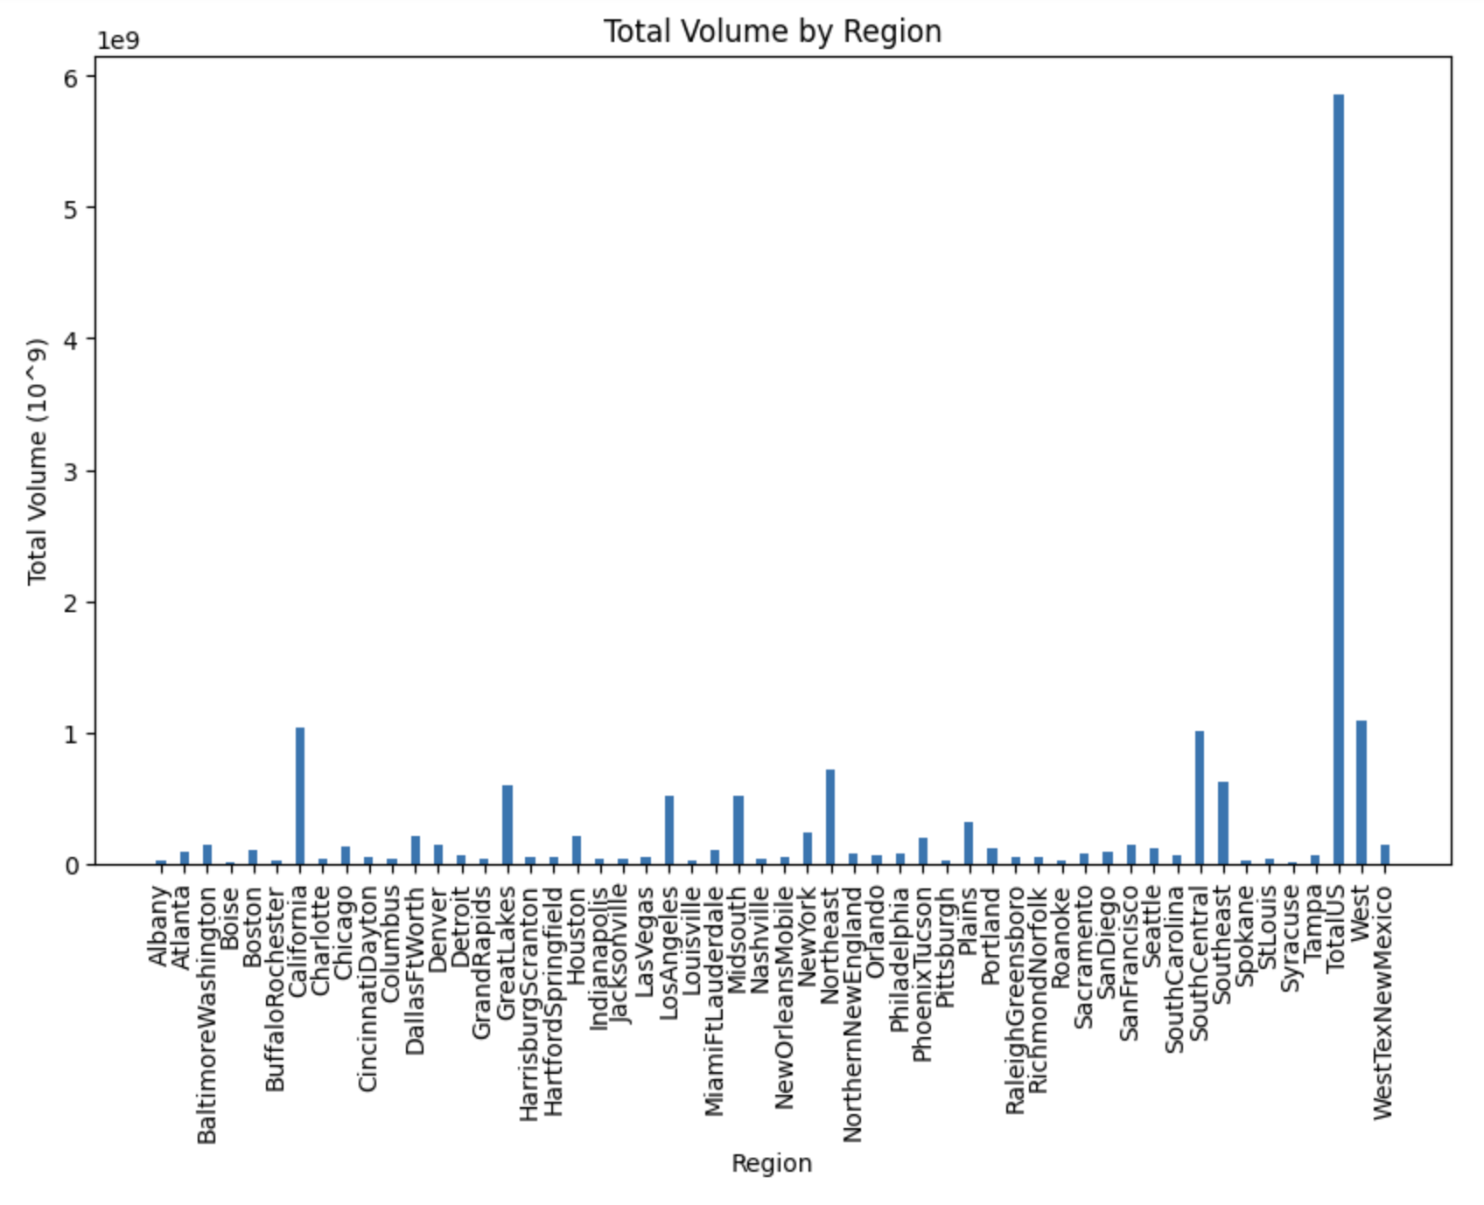
Hypothesis Question #2
Do certain regions have different demand levels of avocado overall?
H0 : p_{atlanta} = p_{albany}
Ha : p_{atlanta} ≠ p_{albany}
Two proportion Z test results:
Alpha = .05
Test statistic = 1.04795
Assumptions = each proportion sample is greater than 15
p-value = 0.294659, fail to reject null hypothesis

Slide 6
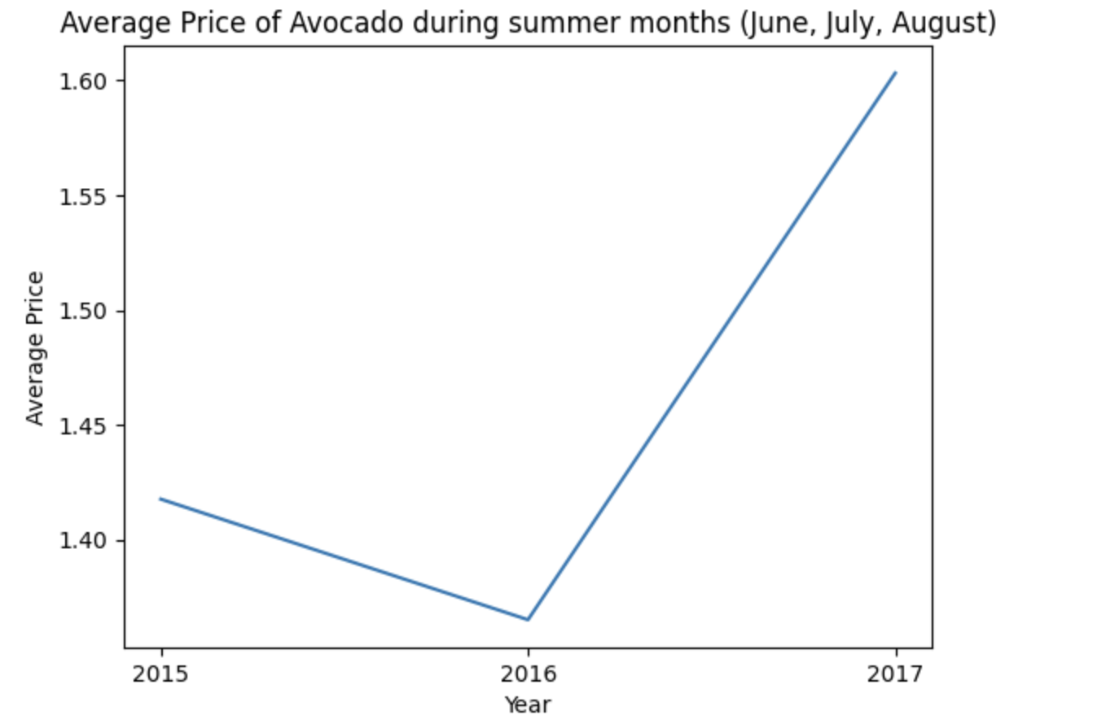
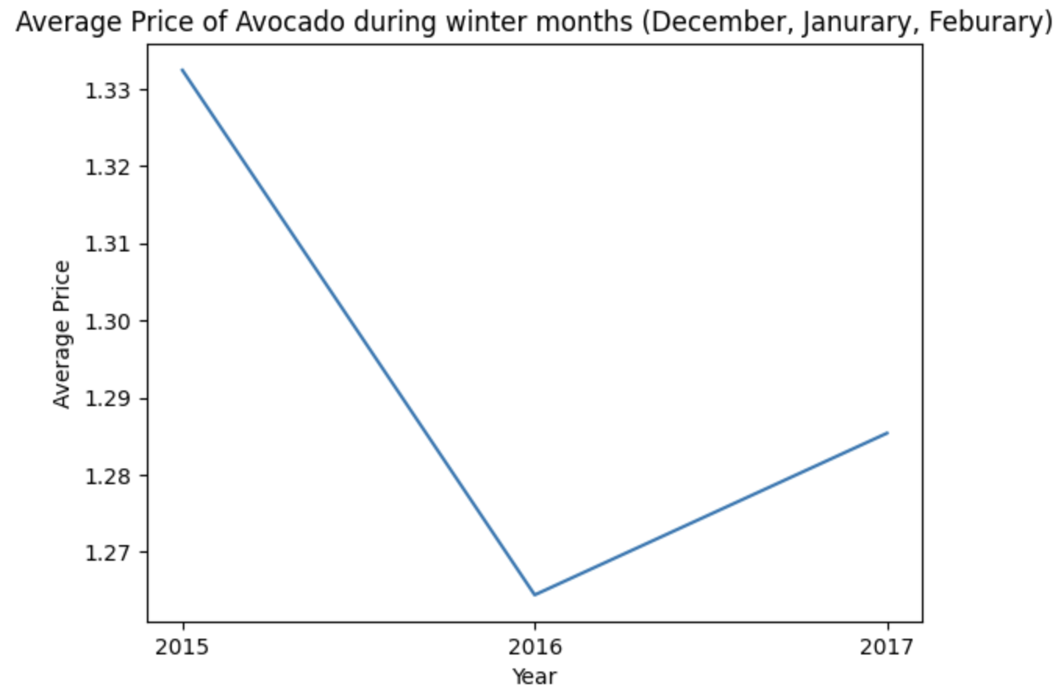
Hypothesis Question #3
Are avocados sold in the summer months more expensive than avocados sold in winter months?
H0: μ_{summer price} = μ_{winter price}
Ha : μ_{summer price} > μ_{winter price}
Alpha = .05
Test statistic = 2.2412
Assumptions: Samples are large
P-value = 0.1372

Slide 7
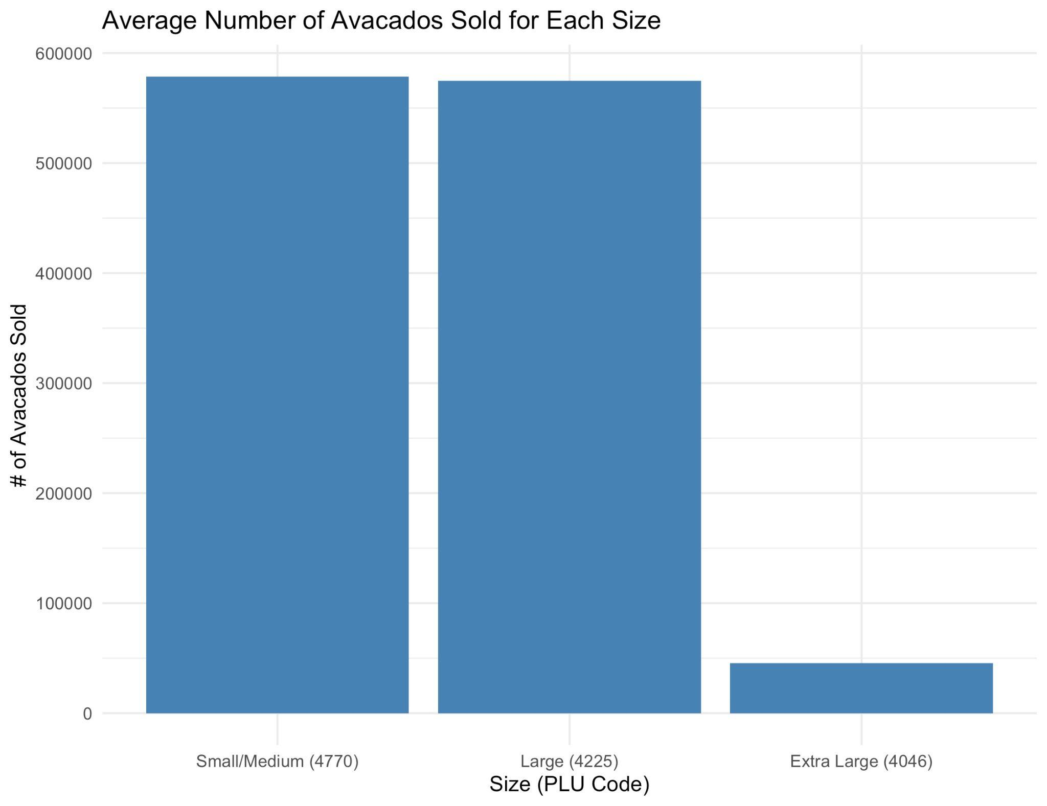
Hypothesis Question #4
How does the size of avocados impact the number of avocados
sold?
H0 : μnumber of small/medium avocados sold = μnumber of extra large avocados sold
Ha : μnumber of small/medium avocados sold ≠ μnumber of extra large avocados sold
Alpha = .05
Test statistic = 29.1266
Assumptions: samples sizes are sufficiently large, using the sample mean as the test statistic
P-value < 0.0001

